Slide 1

SUPERVISED LEARNING

Slide 2


WHAT WILL WE COVER?
Recap of what is supervised learning
Core Concepts required
Classification Algorithms
Regression Algorithms
Data Squad | Supervised Learning

Slide 3
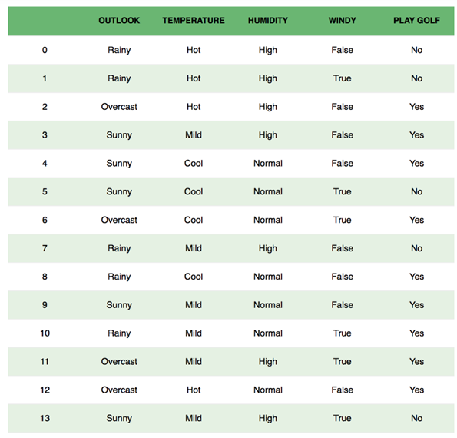

SUPERVISED: SHOULD I PLAY GOLF?
The objective is to predict if based on the weather conditions of a particular day, we should go play Golf?
Data Squad | Supervised Learning

Slide 4
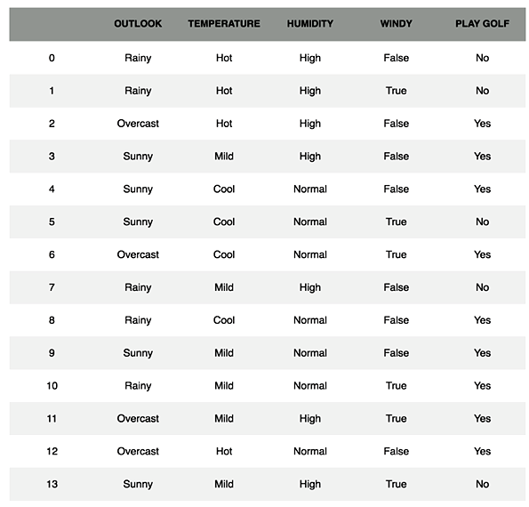
SUPERVISED: SHOULD I PLAY GOLF?
But how does my algorithm learn?
Based on past datapoints!!!
This is the "Supervised" component
These are called the labels
Supervised Learning is performed on labelled data
Data Squad | Supervised Learning

Slide 5






THE MACHINE LEARNING PROCESS
Labeled Data
Feature Engineering
Train-Test Split
Process of obtaining labeled data is tricky and many times the bottleneck of obtaining an efficient algorithm
Pick Algorithm & Hyperparameters
Optimize Parameters of Algorithm
Evaluate Algorithm with appropriate metric
Based on Loss Function
Data Squad | Supervised Learning

Slide 6
THE MACHINE LEARNING PROCESS
Labeled Data
Feature Engineering
Train-Test Split
Pick Algorithm & Hyperparameters
Optimize Parameters of Algorithm
Evaluate Algorithm with appropriate metric
Based on Loss Function
Data Squad | Supervised Learning

Slide 7
THE MACHINE LEARNING PROCESS
Labeled Data
Feature Engineering
Train-Test Split
Can be done in a conventional way or with more advaned technique (balancing dataset or cross validation)
Pick Algorithm & Hyperparameters
Optimize Parameters of Algorithm
Evaluate Algorithm with appropriate metric
Based on Loss Function
Data Squad | Supervised Learning

Slide 8
THE MACHINE LEARNING PROCESS
Labeled Data
Feature Engineering
Train-Test Split
This is where you earn your salary. With experience you will have intuition of which algorithm will be best suited for your situation. The hyperparameters have to be set
Pick Algorithm & Hyperparameters
Optimize Parameters of Algorithm
Evaluate Algorithm with appropriate metric
Based on Loss Function
Data Squad | Supervised Learning

Slide 9
THE MACHINE LEARNING PROCESS
Labeled Data
Feature Engineering
Train-Test Split
Loss Function vs Cost Function
Attributes a Penalty to each incorrect prediction. Parameters are optimized to minimize this
Pick Algorithm & Hyperparameters
Optimize Parameters of Algorithm
Evaluate Algorithm with appropriate metric
Based on Loss Function
Data Squad | Supervised Learning

Slide 10
THE MACHINE LEARNING PROCESS
Labeled Data
Feature Engineering
Train-Test Split
Once we are happy with our algorithm training we need to see an appropriate evaluation metric to make our final judgement
Pick Algorithm & Hyperparameters
Optimize Parameters of Algorithm
Evaluate Algorithm with appropriate metric
Based on Loss Function
Data Squad | Supervised Learning

Slide 11

THE MACHINE LEARNING PROCESS
Labeled Data
Feature Engineering
Train-Test Split
Pick Algorithm & Hyperparameters
Optimize Parameters of Algorithm
Evaluate Algorithm with appropriate metric
Based on Loss Function
Data Squad | Supervised Learning

Slide 12
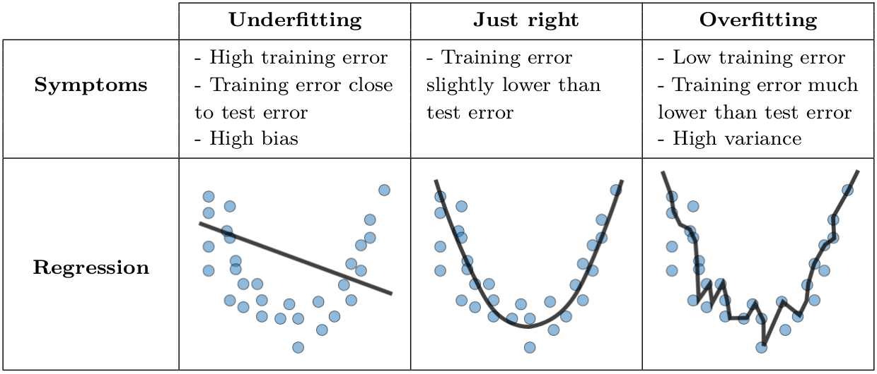
CLASSIFICATION ALGORITHMS
This is the biggest danger when creating machine learning algorithms
Underfitting: model is too simplistic
Overfitting: model adapts too much to the training data and does not generalize properly
Data Squad | Supervised Learning

Slide 13
CLASSIFICATION ALGORITHMS
Model Generelization is how well will the trained model perform on new unseen data?
This is why we perform the train-test split!!!
This way we give the algorithm some data to train, and then a smaller sample to test how does the model behave on unseen data
Data Squad | Supervised Learning

Slide 14
EVALUATION METRICS

Slide 15
PERFORMANCE EVALUATION METRICS -
ACCURACY
So far we have just been evaluating the performance of our algorithms based on accuracy
#correct Prediction
Total # of Predictions
Data Squad | Supervised Learning

Slide 16
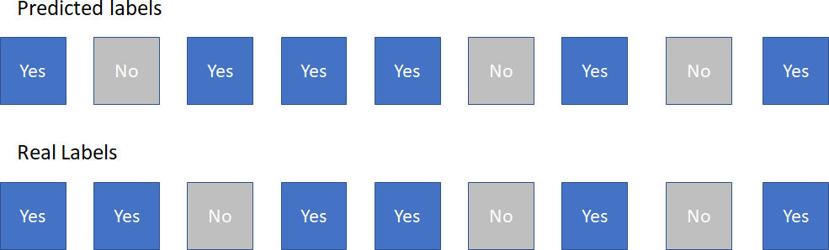
PERFORMANCE EVALUATION METRICS -
ACCURACY
So far we have just been evaluating the performance of our algorithms based on accuracy
#correct Prediction
Total # of Predictions
Data Squad | Supervised Learning

Slide 17
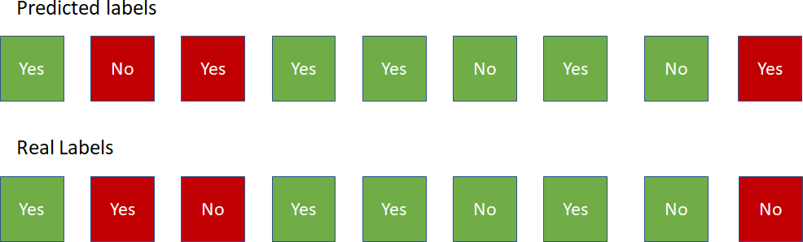
PERFORMANCE EVALUATION METRICS -
ACCURACY
#correct Prediction
Total # of Predictions
So far we have just been evaluating the performance of our algorithms based on accuracy
Data Squad | Supervised Learning

Slide 18
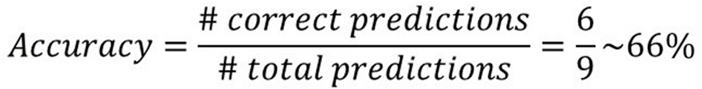
PERFORMANCE EVALUATION METRICS -
ACCURACY
#correct Prediction
Total # of Predictions
So far we have just been evaluating the performance of our algorithms based on accuracy
Data Squad | Supervised Learning

Slide 19

PERFORMANCE EVALUATION METRICS -
ACCURACY
How can accuracy be deceptive?
Imbalanced Datasets
Importance of incorrect prediction of a certain class
#correct Prediction
Total # of Predictions
Data Squad | Supervised Learning

Slide 20
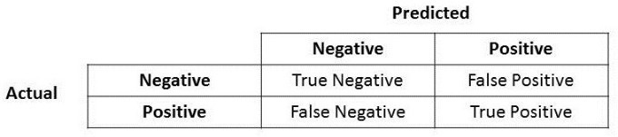
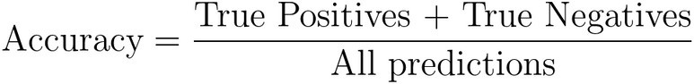

PERFORMANCE EVALUATION METRICS –
CONFUSION MATRIX
Data Squad | Supervised Learning

Slide 21



PERFORMANCE EVALUATION METRICS –
CONFUSION MATRIX
Type I error
Type II error
Data Squad | Supervised Learning

Slide 22
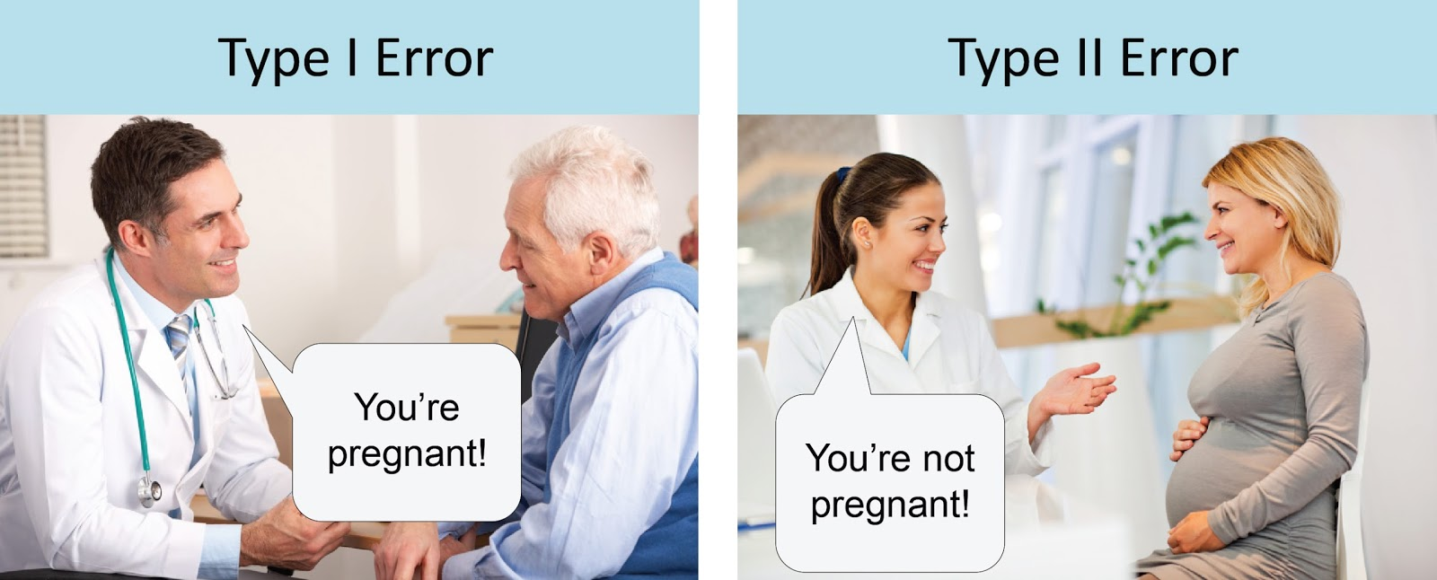
PERFORMANCE EVALUATION METRICS –
CONFUSION MATRIX
Type I error
Type II error
Data Squad | Supervised Learning

Slide 23
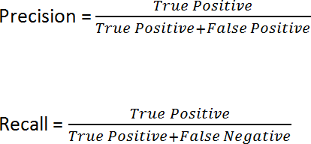
PERFORMANCE EVALUATION METRICS –
CONFUSION MATRIX
Data Squad | Supervised Learning

Slide 24




PERFORMANCE EVALUATION METRICS - PRECISION & RECALL
Let's describe these two concepts through words & intuition
Precision of Class A:
From all the datapoints I predicted to be "A", how many were A?
Example: From a universe of 1000 people, we predicted 10 had coronavirus. In fact only 8 out of these 10 were actually infected.
Precision = 8/10 == 80%
Data Squad | Supervised Learning

Slide 25


PERFORMANCE EVALUATION METRICS - PRECISION & RECALL
Let'sdescribethesetwoconceptsthroughwords&intuition
Recall of Class A:
Fromallthedatapointsthattrulywere"A",howmanydidwepredict?
Example: From a universe of 1000 people, 100 are actually infected with coronavirus(wedonotknowthis,ofcourse)wecorrectlypredictedthat50 peoplehadthevirus
Recall=50/100==50%
Data Squad | Supervised Learning

Slide 26



PERFORMANCE EVALUATION METRICS - PRECISION & RECALL
Which one should we prioritize?
DEPENDS ON THE PROBLEM
However, we have to learn how to decide which one we want to prioritize: Predict if a patient has cancer
Brute Force Precision: only claim the patient has cancer if every single test comes up true multiple times in a row
Brute Force Recall: assume that a patient has cancer "to play it safe" before more tests come in
Data Squad | Supervised Learning

Slide 27



PERFORMANCE EVALUATION METRICS - PRECISION & RECALL
Which one should we prioritize?
Data Squad | Supervised Learning

Slide 28

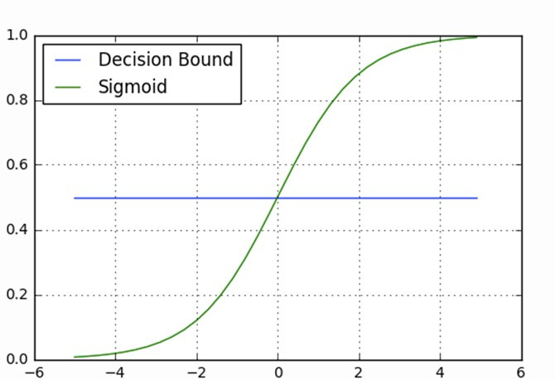
PERFORMANCE EVALUATION METRICS - LOGISTIC REGRESSION
How do you relate the decision boundary to precision/recall in the logistic regression algorithm?
Class 1
Sigmoid(z)
Class 0
z
Data Squad | Supervised Learning

Slide 29
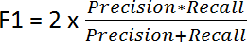
PERFORMANCE EVALUATION METRICS - F1 SCORE
A Trade-off between both such that the algorithm doesn't improve too much one of them at the expense of the other
Data Squad | Supervised Learning

Slide 30
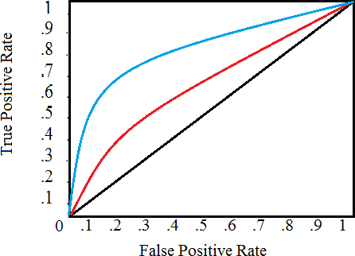
PERFORMANCE EVALUATION METRICS - ROC CURVE
It is a plot of the false positive rate (x-axis) versus the true positive rate (y-axis) for a number of different candidate threshold values between 0.0 and 1.0. Put another way, it plots the false alarm rate versus the hit rate.
Data Squad | Supervised Learning

Slide 31



CLASSIFICATION ALGORITHMS
KNN (Regression Friendly) (Multi Class)
Logistic Regression
Decision Trees (Regression Friendly) (Multi Class)
Naive-Bayes Classifier (Multi Class)
Support Vector Machine (SVM)
Data Squad | Ensemble Learning

Slide 32

CLASSIFICATION ALGORITHMS
K- Nearest Neighbours (KNN)
The Copy-Cat of the Neighbours
Hyperparameters:
K - # of neighbours
Method of weight of neighbours
Data Squad | Ensemble Learning

Slide 33
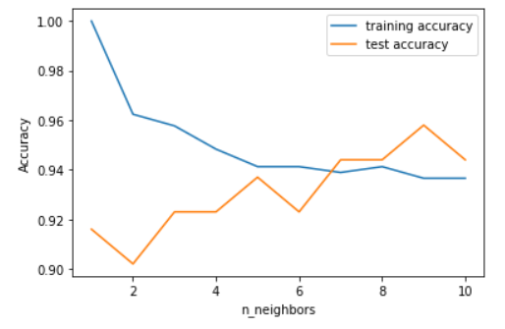
K NEAREST NEIGHBOURS
Example of Overfitting and training vs test tradeoff
go to colab

Slide 34

Jupyter Notebook on this Algorithm
Data Squad | Supervised Learning

Slide 35

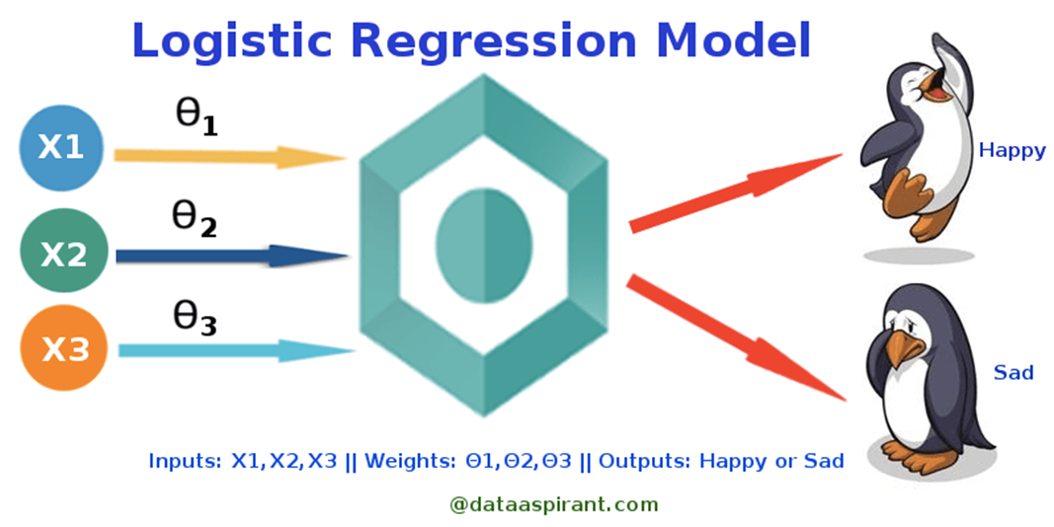
LOGISTIC REGRESSION
Binary Classification Algorithm
Takes in numerical inputs and
Hyperparameter: Decision Boundary
Data Squad | Supervised Learning

Slide 36
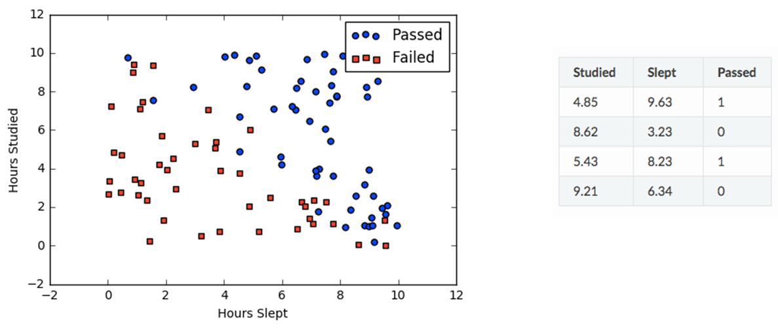
LOGISTIC REGRESSION
Steps:
Perform usual linear Regression
Pass result through sigmoid function
Compare result to decision boundary
Make Prediction
Data Squad | Supervised Learning

Slide 37
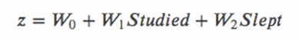
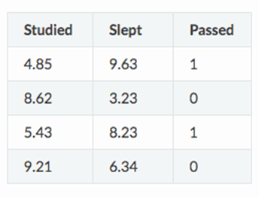
LOGISTIC REGRESSION - LINEAR REGRESSION STEP
Here there is the need to optimize the parameters of the linear regression
But do we compare z directly to something?
NO
Data Squad | Supervised Learning

Slide 38


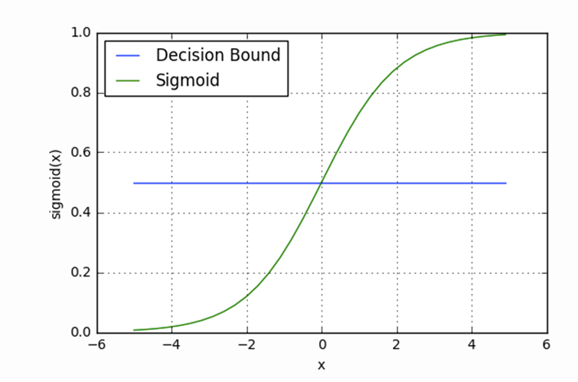

LOGISTIC REGRESSION - SIGMOID FUNCTION
This is where things become Nonlinear
Data Squad | Supervised Learning

Slide 39



LOGISTIC REGRESSION
Data Squad | Supervised Learning

Slide 40


LOGISTIC REGRESSION
Data Squad | Supervised Learning

Slide 41
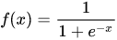
LOGISTIC REGRESSION - SIGMOID FUNCTION
This is where things become Nonlinear
z
z
Data Squad | Supervised Learning

Slide 42


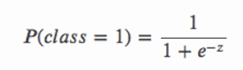
LOGISTIC REGRESSION - SIGMOID FUNCTION
Class 1
Sigmoid(z)
Decision Boundary
Class 0
z
Data Squad | Supervised Learning

Slide 43
LOGISTIC REGRESSION - SIGMOID FUNCTION
Class 1
For a set of the regression parameters, predictions are made and then compared with labels
instead of maximising the # of correct answers, ML algos usually try to minimize the # errors...
Sigmoid(z)
Decision Boundary
Class 0
z
Data Squad | Supervised Learning

Slide 44
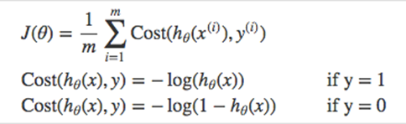
LOGISTIC REGRESSION - SIGMOID FUNCTION
For a set of the regression parameters, predictions are made and then compared with labels
Cost Function is used to evaluate "Penalty"
Class 1
Sigmoid(z)
Decision Boundary
Class 0
z
Data Squad | Supervised Learning

Slide 45
Jupyter Notebook on this Algorithm

Slide 46
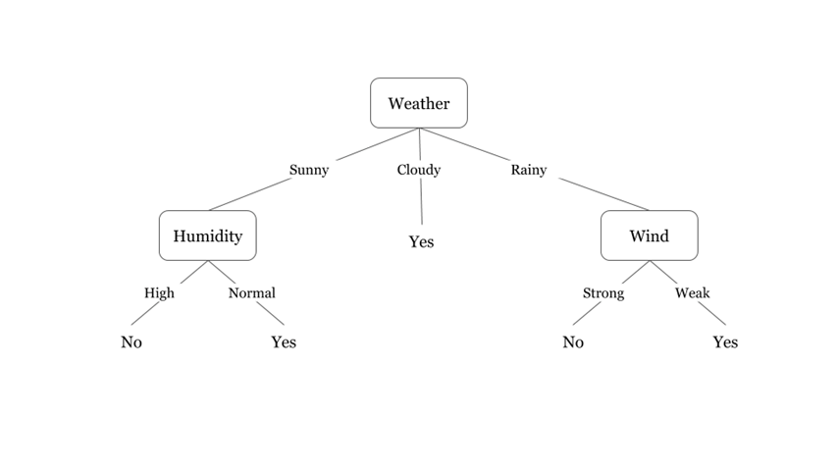
DECISION TREES
Each level of the tree asks a "question" about a specific feature and divides the paths into several nodes
number of levels is known as the tree depth
Trees are constructed by trying different combinations of features
Data Squad | Supervised Learning

Slide 47

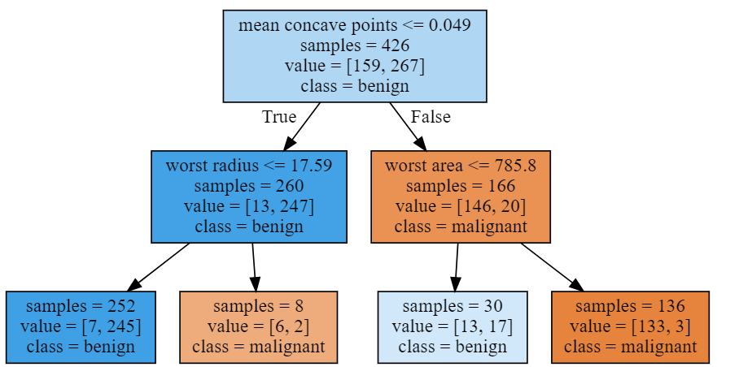

Very simple to build and train
Very robust to different types of features
DECISION TREES
Quickly Overfit if hyperparameters are not controlled
Generalization Problems: what happens if feature outside possible ranges appears?
Online Learning problem: quickly change when re-trained
Data Squad | Supervised Learning

Slide 48
Jupyter Notebook on this Algorithm

Slide 49
NAIVE BAYES - WHAT ABOUT THOSE PESKY CATEGORICALS?
et’s say you have a table of registered voters in the USA, and the following features
Registered | Age group | Wealth | Education | Location
Democrat | Young | Middle Class | Higher | Urban
Independent | Middle Aged | Middle Class | Post Grad | Urban
Republican | Middle Aged | Rich | Post Grad | Rural
Democrat | Old | Middle Class | Higher | Rural
Republican | Middle Aged | Middle Class | Higher | Rural
Republican | Old | Poor | Basic | Rural
Democrat | Middle Aged | Middle Class | Post Grad | Urban
Democrat | Young | Poor | Basic | Urban
Independent | Old | Middle Class | Higher | Rural
You are interested in, given a non-registered voter for which you know the features, to understand how likely that voter is to vote Democrat, Republican or Independent.
This is not an exercise that you can do with a regression or even using classic statistics since you have no numeric variables whatsoever, so what can you do in this case?
Let’s suppose we get the following prospective voter features:
Age group | Wealth | Education | Location
Old | Middle Class | Post Grad | Rural
Data Squad | Supervised Learning

Slide 50

NOTE ON SENSITIVIY AND GENERALIZATIONS IN THE CLASSROOM DUE TO POLITICAL GENERALIZATIONS

Slide 51
NAIVE BAYES
We could try to fit this voter with the majority of the voters that have exactly these features
Age group | Wealth | Education | Location
Old | Middle Class | Post Grad | Rural
But this has 2 problems
We may never have observed this exact combination of characteristics
We don’t want a “one rule” for all Old, Middle Class, Post Grad, Rural people. Some combinations are certainly more indicative of party affiliation than others
What we really would like is to be able to compare
Data Squad | Supervised Learning

Slide 52
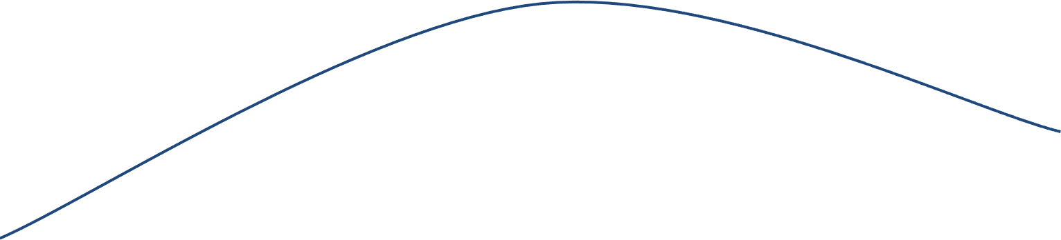
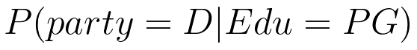
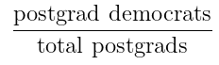
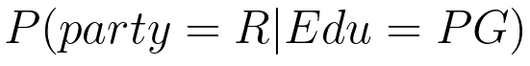
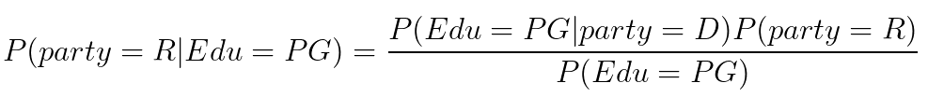
NAIVE BAYES - back to reality, simplified
Let’s try a simpler problem
In this case we could estimate this probability directly (see arrow) but let’s try a different approach.
Remember Bayes Rule?
Data Squad | Supervised Learning

Slide 53
NAIVE BAYES - back to reality, simplified
Now, if we are only interested in which of these is larger, we don’t care about the denominator
And we can estimate the right hand side parameters from our table… how?
The point here is that we can compute the probability of the party given the features from the probability of the features given the party...
Data Squad | Supervised Learning

Slide 54
NAIVE BAYES - back to the painful reality
But our problem is not this simple, let’s add back the other variables
What we will do is the same as in the simplified case: compute the probability of the party given the features from the probability of the features given the party
Technically, this requires us to assume that the features are independent from each other in the presence of the voting information, which we assume is more informative than any individual feature. This is the “Naive” assumption in Naive Bayes.
Data Squad | Supervised Learning

Slide 55
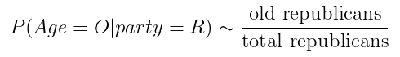
NAIVE BAYES - Don’t freak out!
Now this formula looks daunting, but don’t freak out yet
What are we really saying here?
The denominator is irrelevant because for the democrats we will have the same denominator. Since we are only interested in answering who has the higher probability, R’s or D’s, we don’t need to compute it.
The numerator has a bunch of factors, but they all look the same: what is the probability of being old given that one is republican? What is the probability of being middle class, given that one is republican? Etc etc. We can estimate all of these from our table!
Data Squad | Supervised Learning

Slide 56
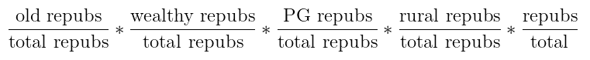
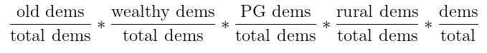
NAIVE BAYES - Don’t freak out!
So in the end our rule
becomes
versus
We just need to compare these quantities to decide which is more likely. Notice we ignore the denominator because it is equal for both the democratic and the republican case.
Data Squad | Supervised Learning

Slide 57
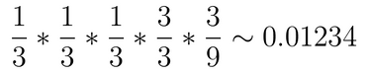
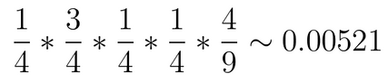
NAIVE BAYES - Who’s this guy after all?
Age group | Wealth | Education | Location
Old | Middle Class | Post Grad | Rural
Registered | Age group | Wealth | Education | Location
Democrat | Young | Middle Class | Higher | Urban
Independent | Middle Aged | Middle Class | Post Grad | Urban
Republican | Middle Aged | Rich | Post Grad | Rural
Democrat | Old | Middle Class | Higher | Rural
Republican | Middle Aged | Middle Class | Higher | Rural
Republican | Old | Poor | Basic | Rural
Democrat | Middle Aged | Middle Class | Post Grad | Urban
Democrat | Young | Poor | Basic | Urban
Independent | Old | Middle Class | Higher | Rural
Since 0.01234 > 0.00521, mystery guy is more likely to be a Republican than a Democrat
Data Squad | Supervised Learning

Slide 58
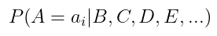
NAIVE BAYES - In short
So, if you have to decide between
For different a_i, you can instead compare
(which should be easy from your table of prior observations)
And take the a_i which makes this value largest.
Data Squad | Supervised Learning

Slide 59

NAIVE BAYES - Issues
The independence assumption: we essentially double count features that are erroneously assumed independent
Zero-frequency problem: probability of said class automatically becomes 0 for said value. We can solve this by adding 1 to every single observation, but we need a somewhat large dataset to make this work.
Conditioning: as we get more and more features, our numbers become very tiny and computers may have trouble doing math with
Data Squad | Supervised Learning

Slide 60
Jupyter Notebook on this Algorithm

Slide 61


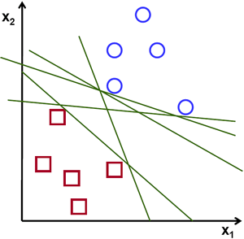


SUPPORT VECTOR MACHINE (SVM)
Data Squad | Supervised Learning

Slide 62
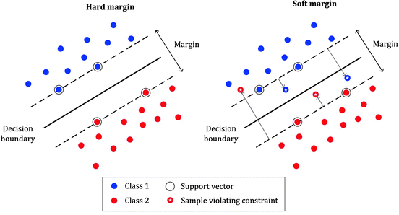
SUPPORT VECTOR MACHINE (SVM)
Our objective is to find a plane that has the maximum margin, i.e the maximum distance between data points of both classes. Maximizing the margin distance provides some reinforcement so that future data points can be classified with more confidence.
Data Squad | Supervised Learning

Slide 63

MACHINE VECTORSUPPORT
Draws the line separating the two classes that maximises the distance
between the data and the line.
. Defined by support vectors, those data points that are closest to the dividing line
Data Squad | Supervised Learning

Slide 64

SVM
Can Model NonLinear Boundaries (if nonlinear version is used)
Unlikely to overfit
Memory intensive: is more successful on small dataset
Data Squad | Supervised Learning

Slide 65

ANY QUESTIONS ?

